Slide 1
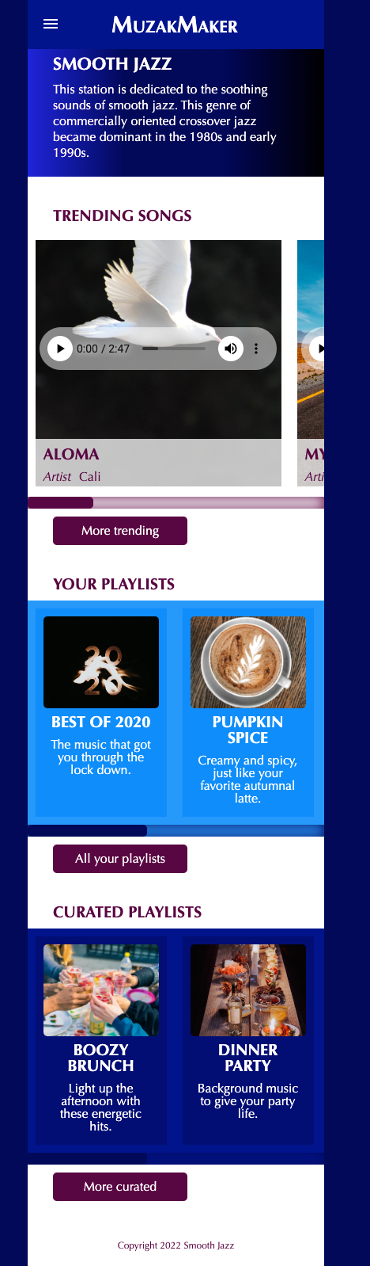
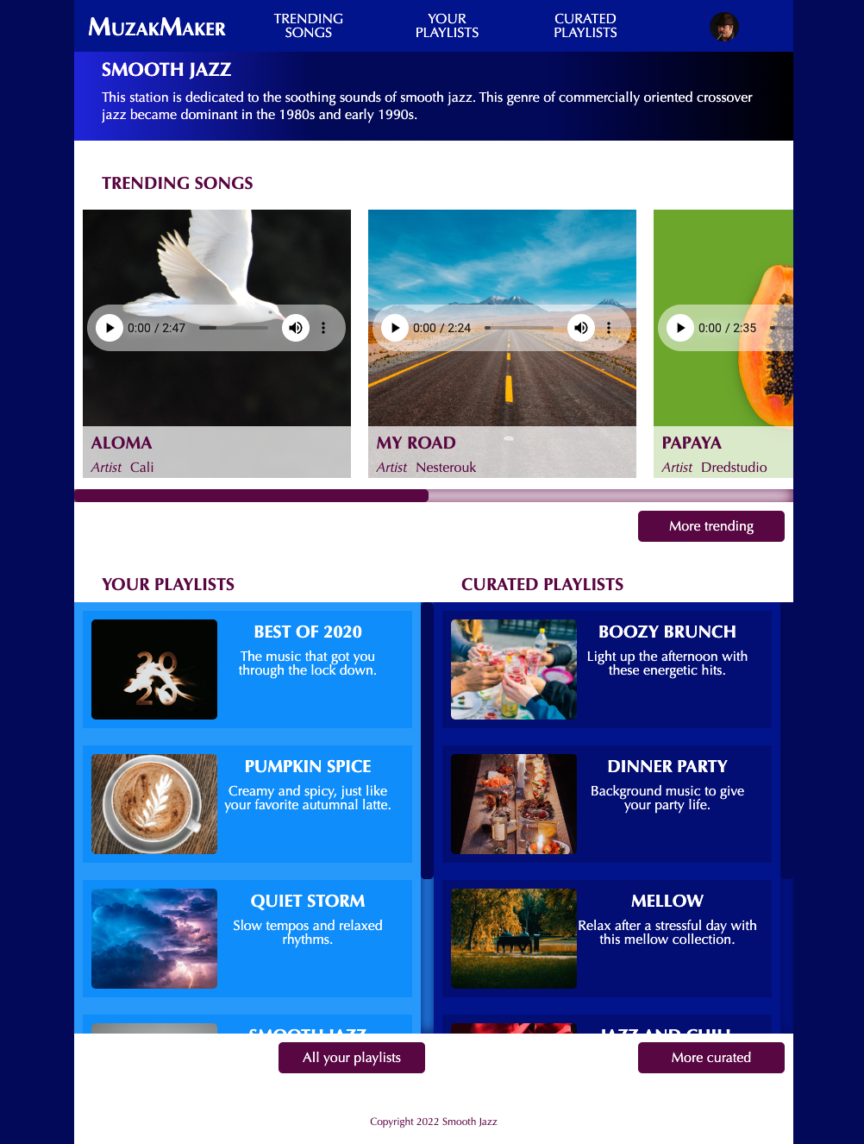
On hover, background-color changes to #590242
375px
834px
MuzakMaker is the first <li> in th <ul> and is styled differently than the others, small-caps
Hamburger menu uses an input checkbox to reveal the whole nav ul
See code provided with Content folder in Google Drive
We will do this together in class
The navigation expands to see all the links which start out hidden by the hamburger menu.
Scrolls to reveal 5 songs
Custom audio player See code provided with Content folder in Google Drive
Custom slider See video https://youtu.be/wGWO5sm8iKM
html background-color is #020659
And body is set to margin:0 auto to display in the center of the viewport window
Moves from the left to the right
Scrolls to reveal 5 playlists
Changes from vertical to horizontal
using only css, no new images
Custom slider
Scrolls to reveal 5 playlists
Changes from vertical to horizontal
using only css, no new images
Custom slider
On hover, background-color changes to #020659

Slide 2
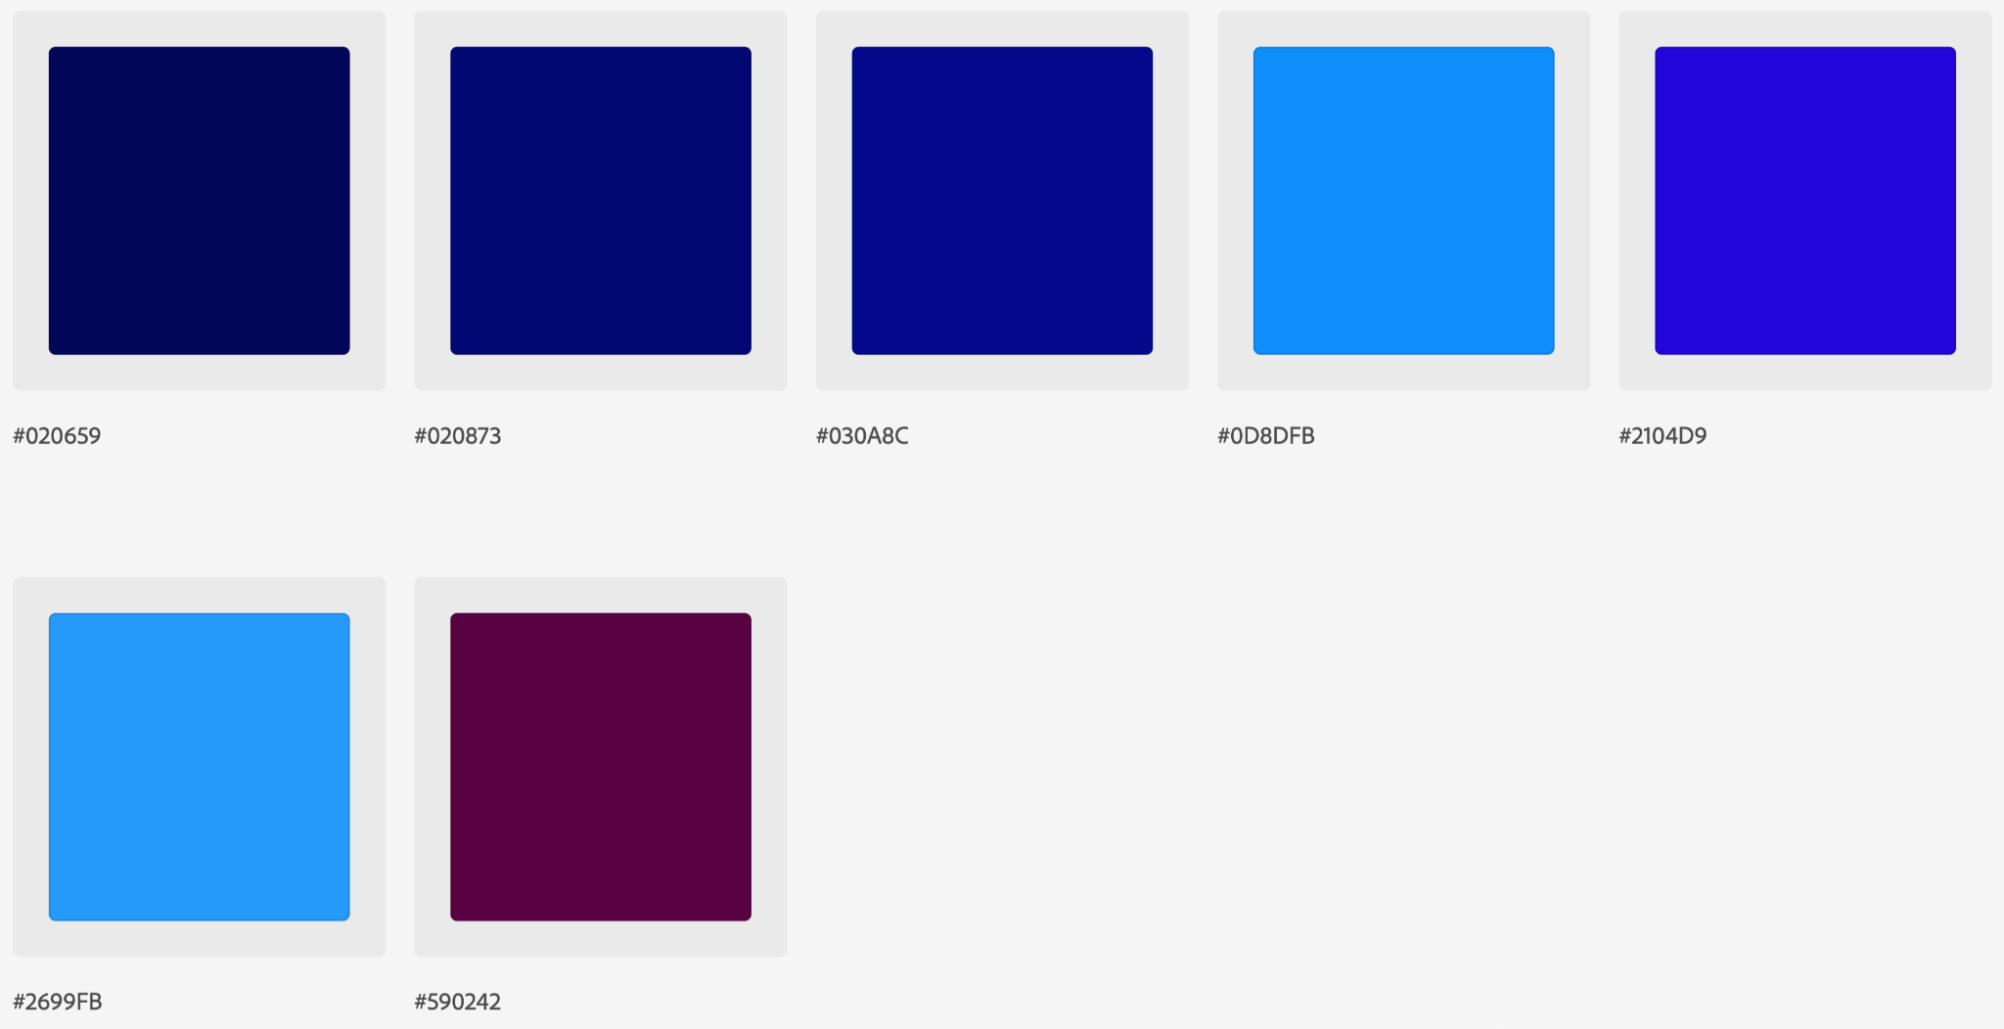
Color Palette

Slide 3
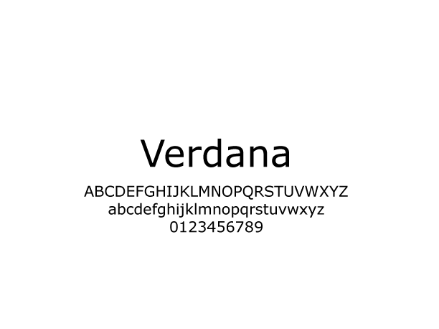
Typography
font-family: Verdana, Geneva, Tahoma, sans-serif;

Slide 4
Font Sizes
h1 {font-size:1.25em;}
h2, h3 {font-size: 1em;}
p, dl, dd {font-size: 1em;}
footer p {font-size: .75em;}

